Slide 1


Into the Data: What’s Coming Down the Pipeline
Nate Strum
Executive Director
GROW Licking County CIC
Rick Szabrak
Director
Fairfield County Economic Development

Slide 2

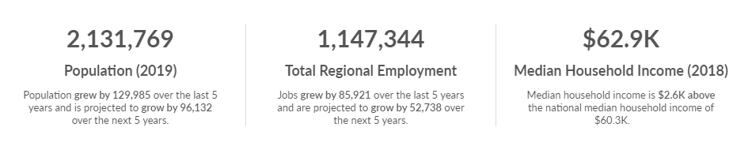
So What’s Happening In Central Ohio
In Short: We. Are. Growing
Columbus Region MSA
Source: Emsi – Columbus MSA Report

Slide 3
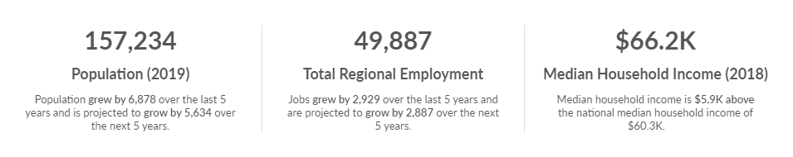

So What’s Happening In Central Ohio
Locally
Fairfield County
Licking County
Source: Emsi – Fairfield County & Licking County Reports

Slide 4
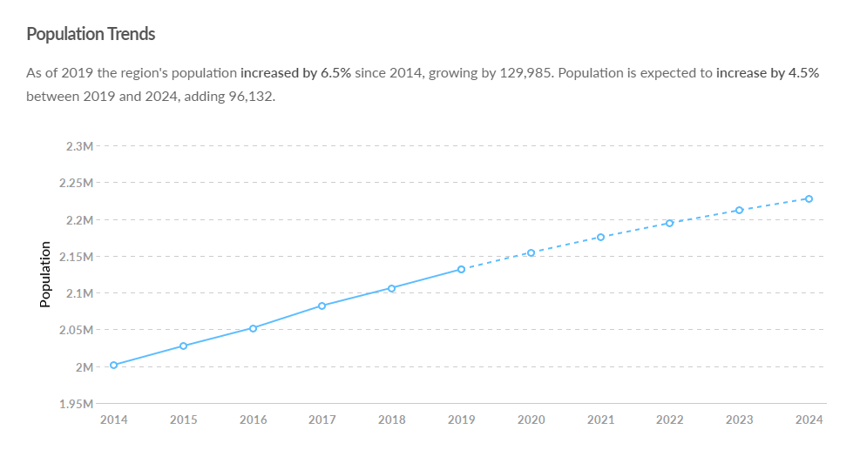
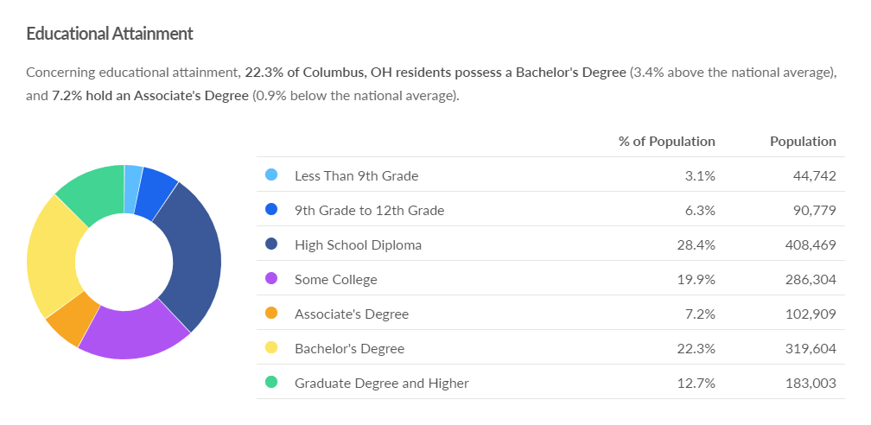
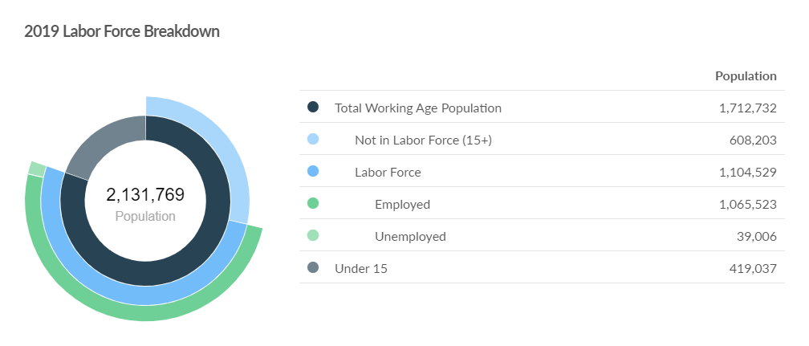
How Are We Growing
Columbus Region MSA
Source: Emsi – Columbus MSA Report

Slide 5
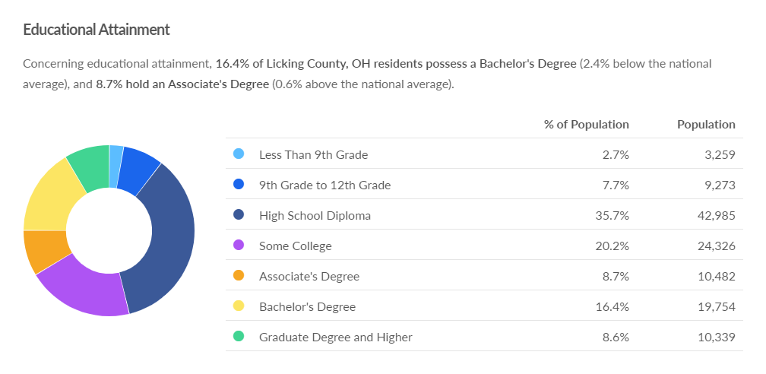
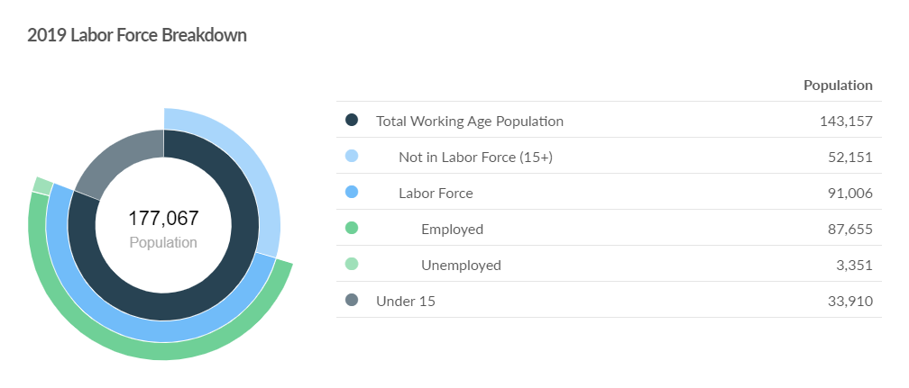

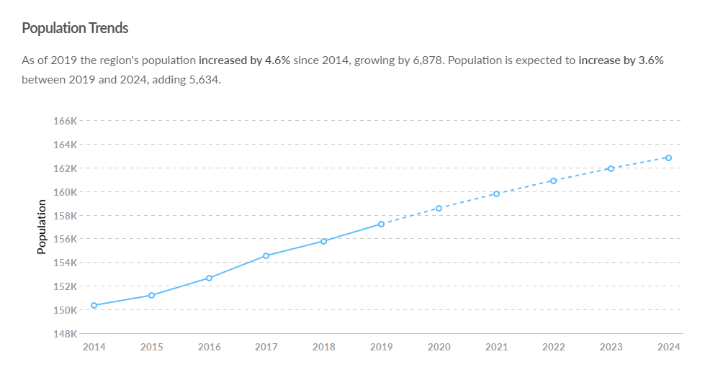
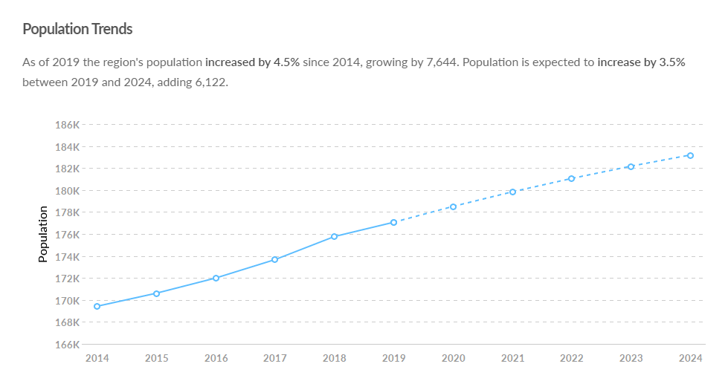

How Are We Growing
Local Impacts - Fairfield
Local Impacts - Licking
Source: Emsi – Fairfield County & Licking County Reports

Slide 6
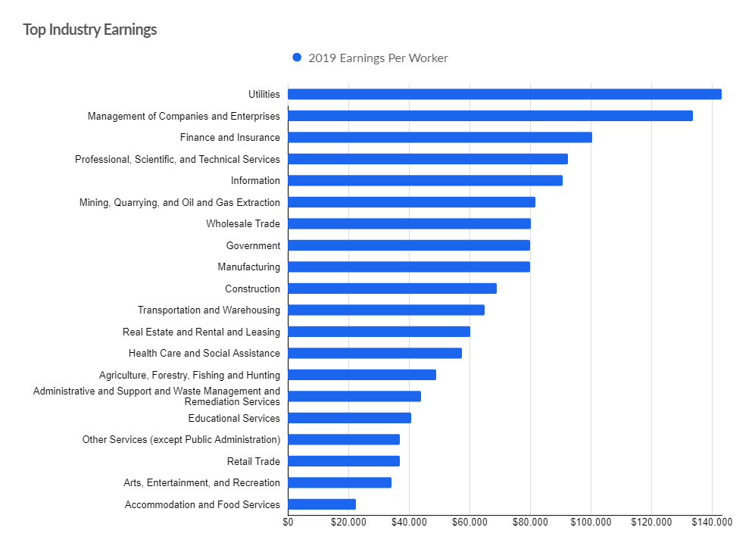
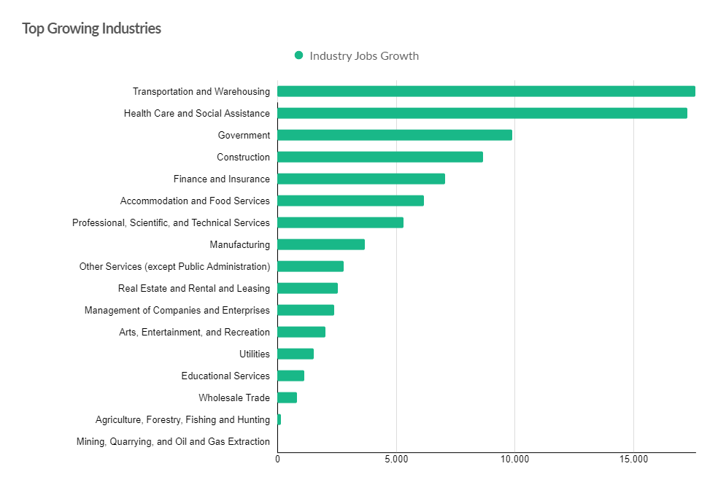
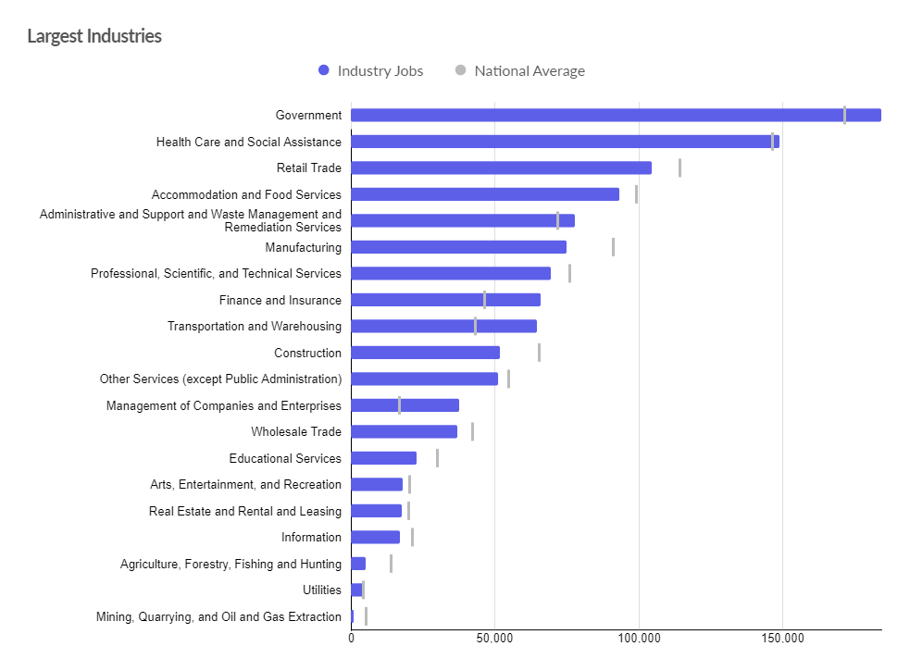
Industry & Job Growth
Columbus Region MSA
Source: Emsi – Columbus MSA Report

Slide 7
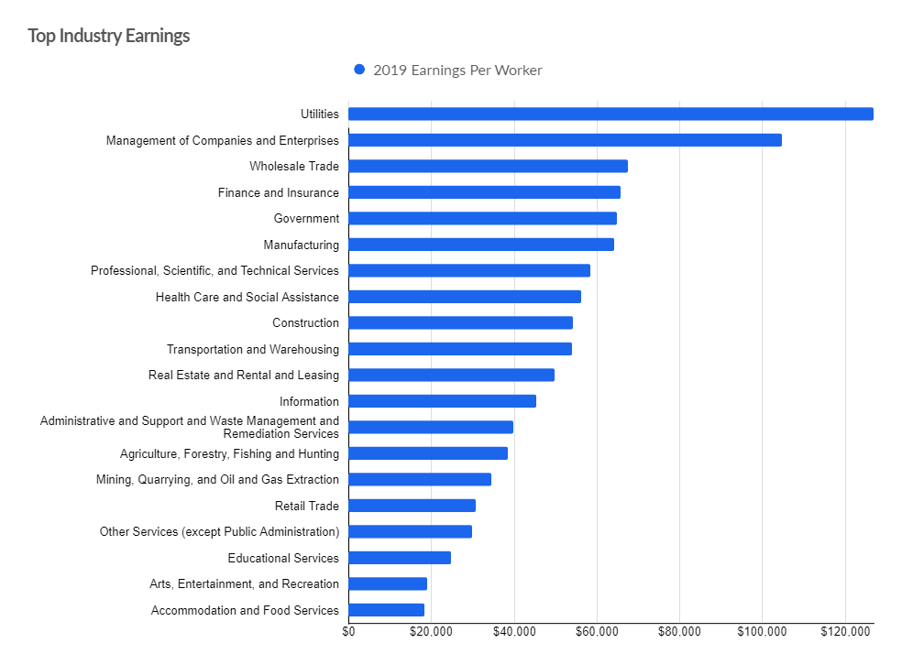
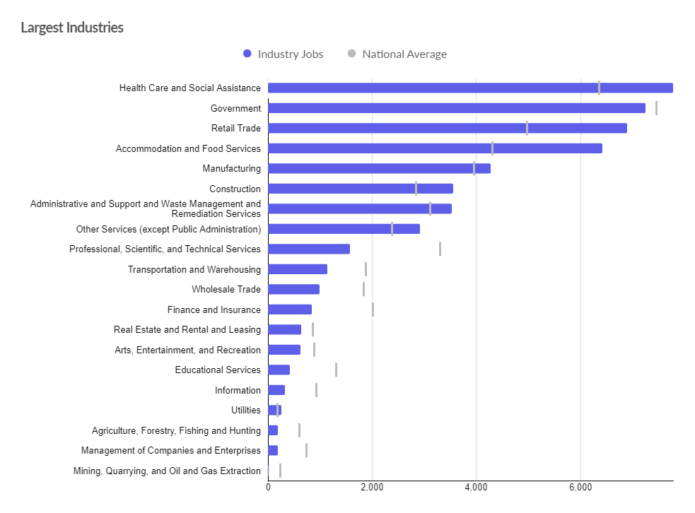
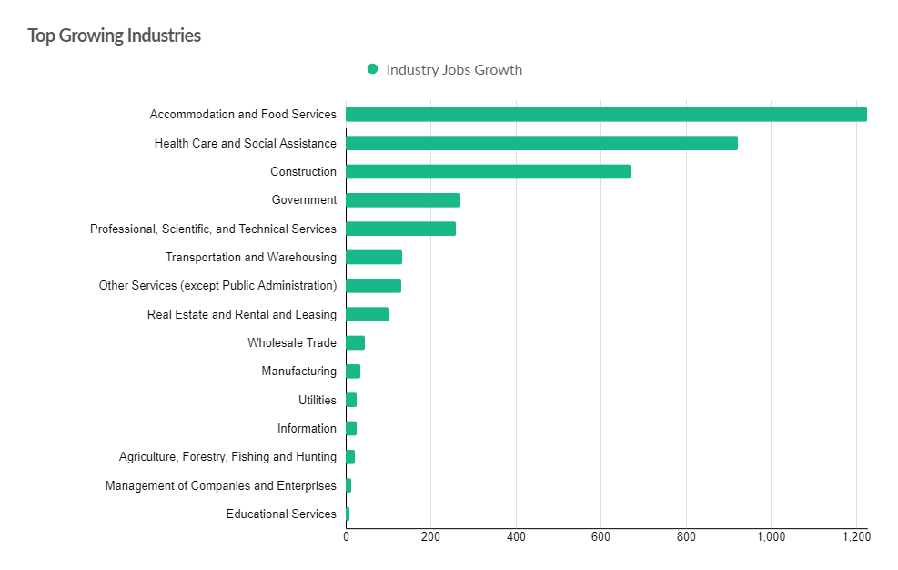
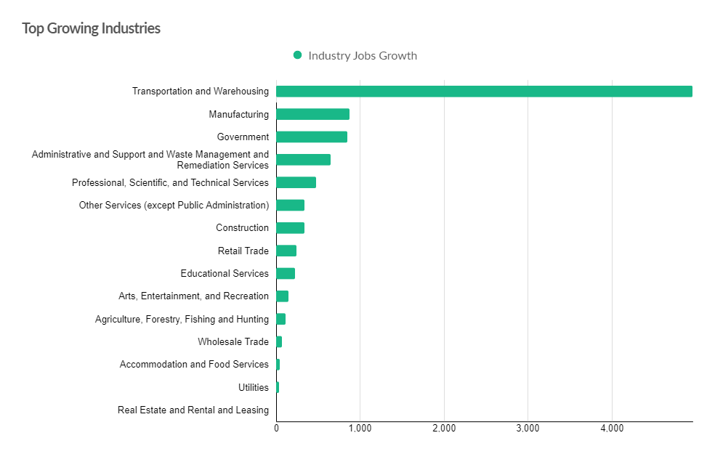
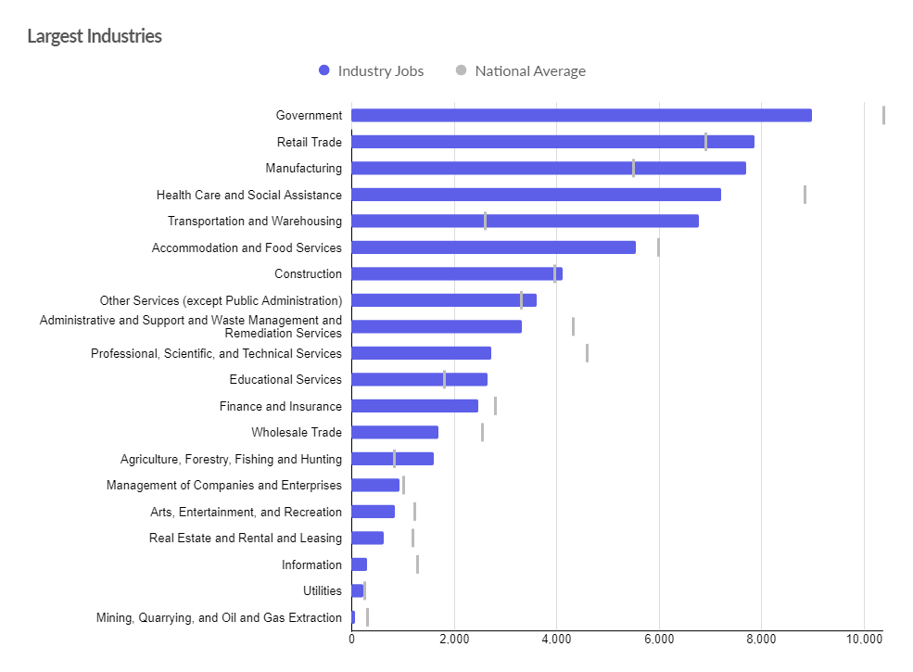
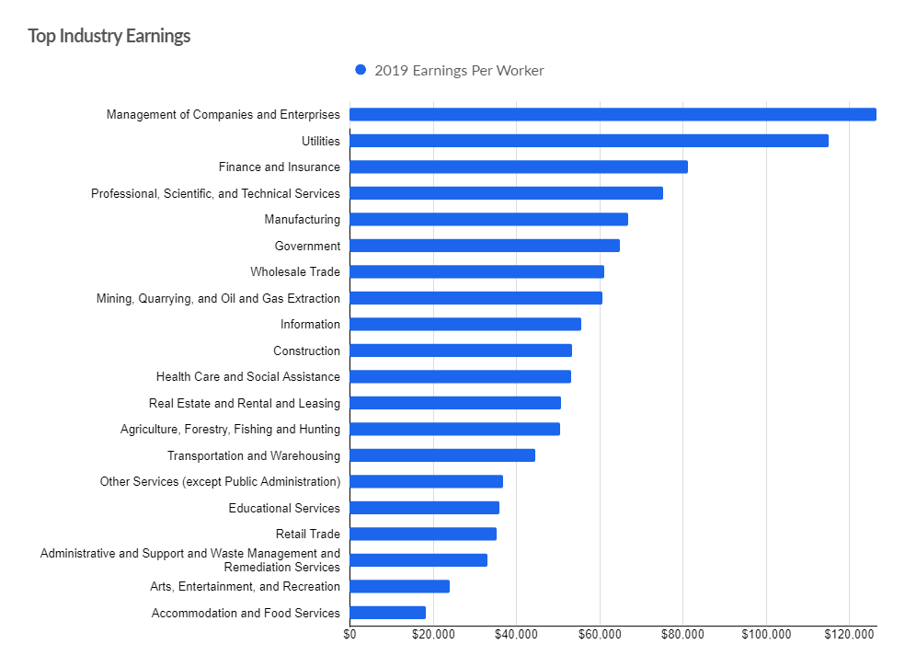
Industry & Job Growth
Local Impacts - Fairfield
Local Impacts - Licking
Source: Emsi – Fairfield County & Licking County Reports

Slide 8
Questions?

